Slide 1
CANDLE Tutorial: Workflow Technologies
ECP Annual Meeting, Houston, TX January 2019
Justin M Wozniak Data Science & Learning
Argonne National Laboratory
woz@anl.gov
www.ExascaleProject.org

Slide 2
Talk Outline
Computing environment
Application cases
Workflow technologies
Performance results
Next steps

Slide 3








Deep learning on supercomputers
Steep learning curve with myriad technologies
Workflow manager (Swift/T, EMEWS) ; Scheduler ; Scripting
Deep learning (Keras, TensorFlow, Horovod)
Optimization algorithms (R, Python)
MPI implementation (MVAPICH, Open MPI)
etc. …
3

Slide 4
CANDLE/Supervisor Goals
Develop an exascale deep learning environment for cancer
Building on open source deep learning frameworks
Optimization for CORAL and exascale platforms
Support all three Pilot project needs for deep learning
Collaborate with DOE computing centers, HPC vendors and ECP co-design and software technology projects
Mission statement: Enable the most challenging deep learning problems in cancer research to run on the most capable supercomputers in the DOE
Provide a path forward for machine learning applications at the largest scale…

Slide 5
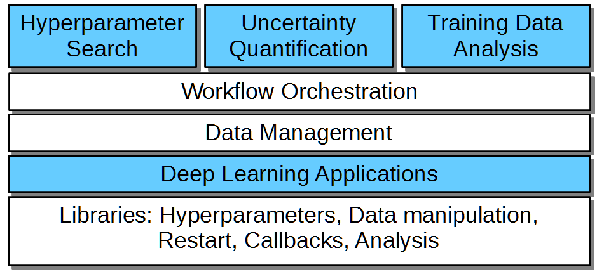
CANDLE/Supervisor overview
CANDLE/Supervisor consists of several high-level workflows:
Capable of modifying/controlling application parameters dynamically as the workflow progresses and training runs complete
Distribute work across large computing infrastructure, manage progress
Underlying applications are Python programs that use Keras/TensorFlow
“User code” shown in blue
“Provided tools” shown in white
New studies would be developed by modifying the blue sections

Slide 6
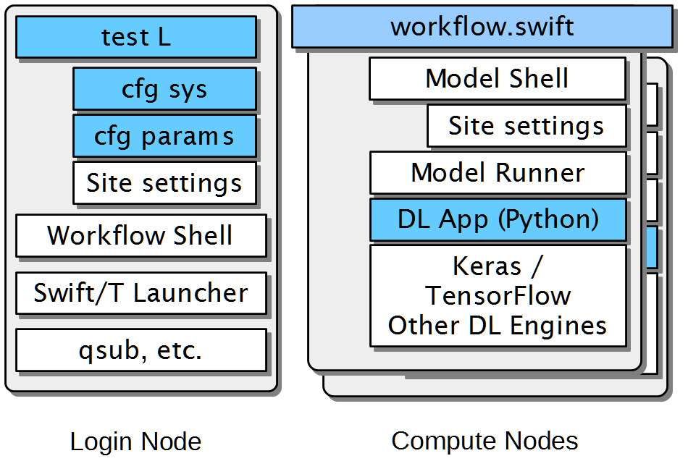
CANDLE/Supervisor Implementation
Runs start with a test script
CFG scripts contain settings for a system or parameters for a given study (e.g., search space)
Reusable site settings
The workflow shell script sets up the run
Swift/T launches and manages the workflow
Reusable Model scripts set up each app run
The DL app uses Keras/TF plus CANDLE Python libraries

Slide 7
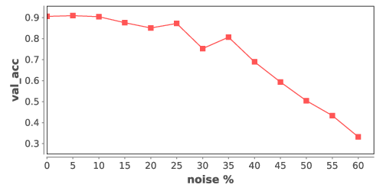
Example: Robustness under noise
float noise_levels[] = [0:num_noises];
int trials[] = [0:num_trials-1];
foreach level, i in noise_levels {
foreach trial, j in trials {
run_id = "%02i-%02i" % (i, j);
json = "{\"noise_level\":%f}"%noise_level;
noise_level = level * noise_step;
result = obj(json, run_id);
printf("result %s : noise %0.3f : %s",
run_id, noise_level, result);
}
}
Simple parameter sweep- measure impact of bad data injection into NT3 model
Workflow script loops over range of noise levels and trials
Parallel loops expose all work to the system concurrently
JSON fragment is assembled with CANDLE hyperparameters
CANDLE obj() function invokes the model scripts to run NT3
Resulting validation accuracy is simply printed to the screen
This will be a topic for the hands-on session
All runs on ALCF Theta, 4,392-node Xeon Phi system

Slide 8
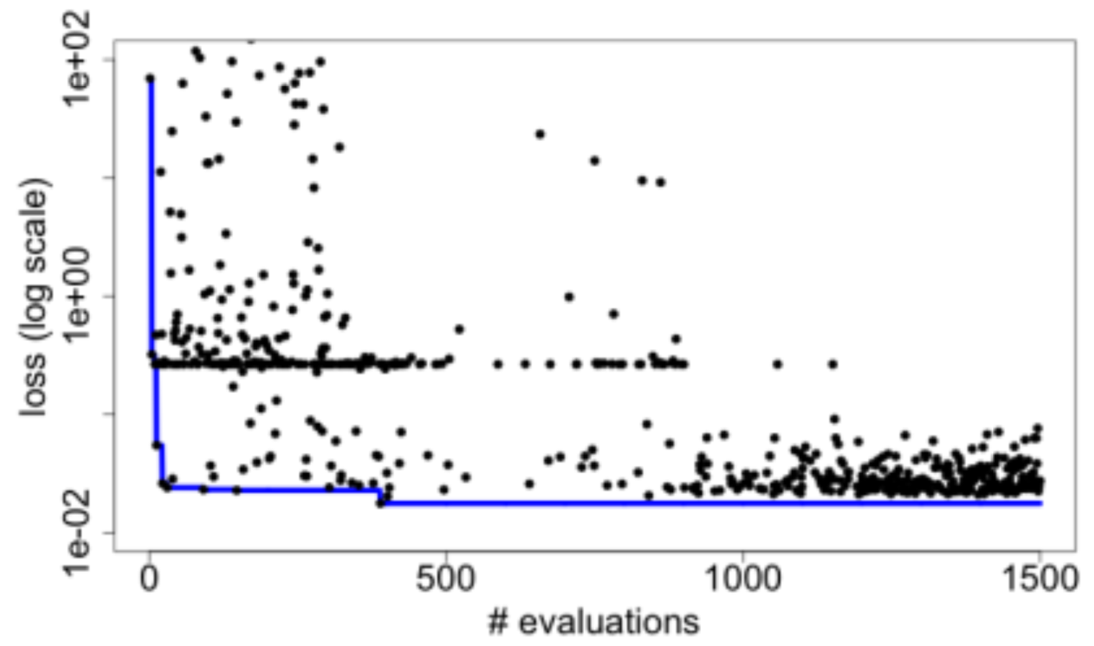
Example: Hyperparameter optimization
for (boolean b = true, int i = 1;
b; b=c, i = i + 1) {
string params = EQR_get(ME);
boolean c;
if (params == "DONE") {
string finals = EQR_get(ME);
c = false;
} else {
string param_array[] = split(params, ";");
string results[];
foreach param, j in param_array {
run_id = "%i_%i_%i" % (restart, i, j);
results[j] = obj(param, run_id);
}
string result = join(results, ";");
EQR_put(ME, result) => c = true;
}
}
Search for the best combination of hyperparameters for a given DL app- neuron counts, functions, etc.
Optimize for validation loss, a measure of error
Use an external R library to perform the optimization
Iteratively receive trial hyperparameters, evaluate them with the obj() function, return results
Algorithm terminates after convergence or iteration limit

Slide 9
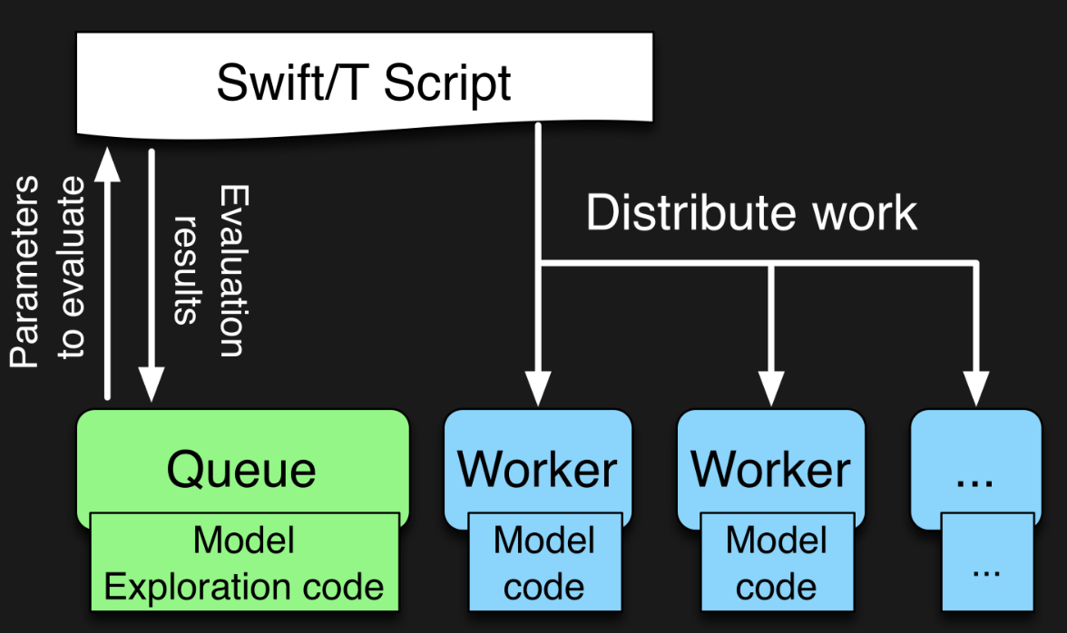

EMEWS workflow structure
The core novel contributions of EMEWS are shown in green, these allow the Swift script to access a running Model Exploration (ME) algorithm, and create an inversion of control (IoC) workflow
Both green and blue boxes accept existing, generic multi-language code- could be anything; we use optimization and deep learning modules
http://emews.org

Slide 10
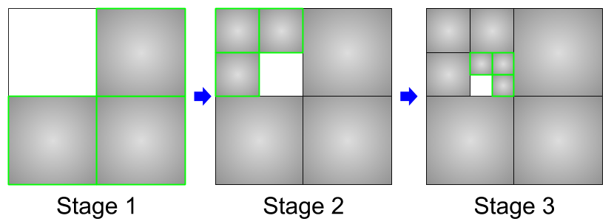
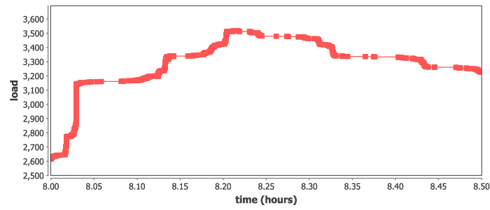
Example: Data analysis workflow
Split up the training data into subsets, iteratively train on most remaining subsets.
Weight sharing from one subset to the next (incremental learning)
Allows for investigations into data quality and learning patterns
Could also boost performance by preventing overloading data ingest limits
Recursive calls define the datasets for train
Runs at large scale on Summit, ramp-up/down
run_stage(int N, int S, string this, int stage,
void block, string plan_id) {
void parent = run_single(this, stage, block, plan_id);
if (stage < S) {
foreach id_child in [1:N] {
run_stage(N, S, this+"."+id_child, stage+1, parent,
plan_id, db_file, runtype);
}}
}
run_single(string node, int stage, void block) {
json_fragment = make_json_fragment(node, stage);
json = "{\"node\": \"%s\", %s}" % (node, json_fragment);
block => obj(json, node);
}

Slide 11
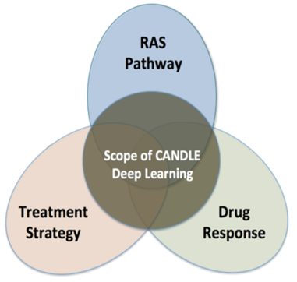
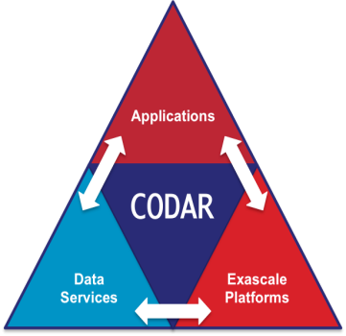
Advanced data management
Swift/T training workflow
CANDLE workflows produce a great number of medium-sized ML models
Goal: Cache these on compute node storage for possible later use
Need to flush to global FS before end of run, but many models will be discarded
Accomplishment: Integrated Swift/T workflow system used in CANDLE with DataSpaces client
Accelerate CANDLE workflow performance, enable novel training strategies (parameter sharing)
Provide an opportunity for workflow-based data analysis and I/O reduction
Demonstrate the utility of node-local storage for complex workflows
CANDLE benchmark
CANDLE
…
TensorFlow
TensorFlow
Good NN model
DataSpaces Services
Parallel FS

Slide 12
Next steps in exascale learning
Enable rapid prototyping via massive parallelism for new workflows
Quickly scale new methods from Python notebooks to supercomputers
Support quick ‘what if’ scenario evaluation for a range of questions
Reusable,
Extensible
ApplicationModels
Reusable,
Extensible
Workflows
Reproducible,
Rapid
Science
+

Slide 13
Thanks
Thanks to the organizers
Code and guides:
CANDLE GitHub: https://github.com/ECP-CANDLE
Swift/T Home: http://swift-lang.org/Swift-T
EMEWS Tutorial: http://www.mcs.anl.gov/~emews/tutorial

Slide 14
Questions?

Slide 15
Acknowledgments
This research was supported by the Exascale Computing Project (ECP), Project Number: 17-SC-20-SC, a collaborative effort of two DOE organizations - the Office of Science and the National Nuclear Security Administration, responsible for the planning and preparation of a capable exascale ecosystem, including software, applications, hardware, advanced system engineering and early testbed platforms, to support the nation's exascale computing imperative.
www.ExascaleProject.org

